Slide 1

Cryptovisor: A Cryptocurrency Advisor Tool
Matthew Baldree, Paul Widhalm and Brandon Hill

Slide 2
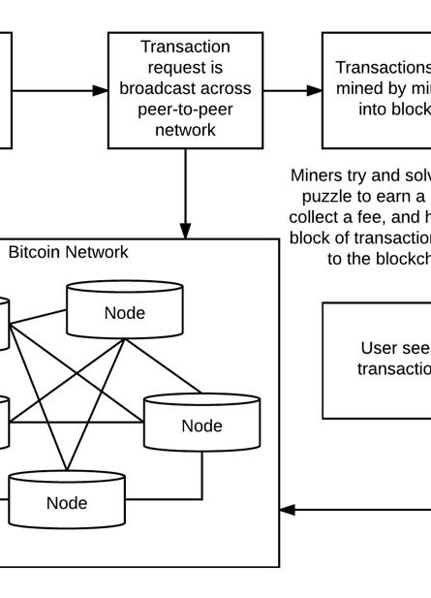

Blockchain
First conceptual work on secured chain of blocks in 1991 by Stuart Haber and W. Scott Stornetta
Decentralized
Distributed
Public Ledger

Slide 3

Cryptocurrencies
First blockchain work conceptualized in 2008 by person (or group) Satoshi Nakamoto
Public Ledger Records Transactions
Blocks Hold Valid Transactions
Validated Through Peer-to-Peer Network

Slide 4
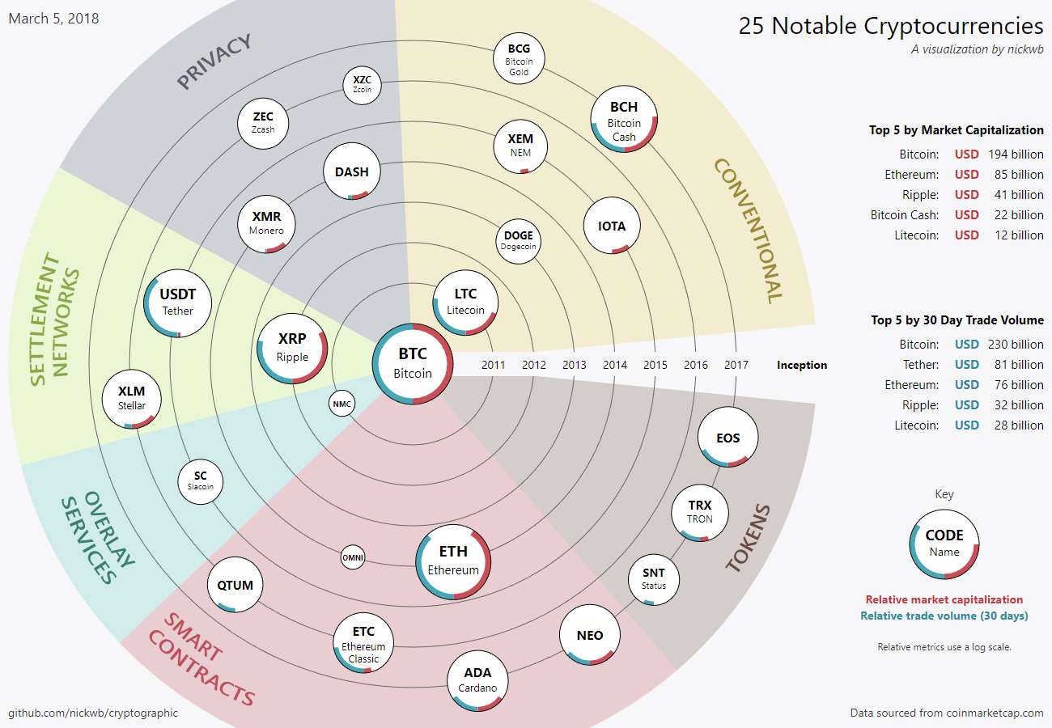
Types of Cryptocurrencies
Bitcoin Started in 2009
Other Coins:
Litecoin (2011)
Ethereum (2015)
Zcash
Dash
Etc…
As of March 2018, over 1,500 coins and increasing!

Slide 5
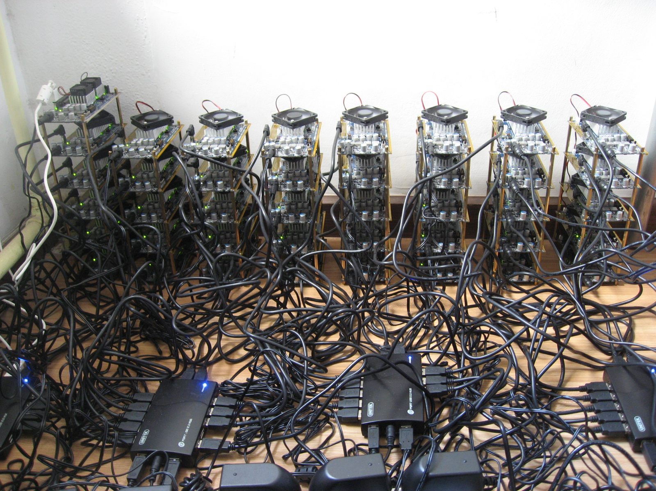
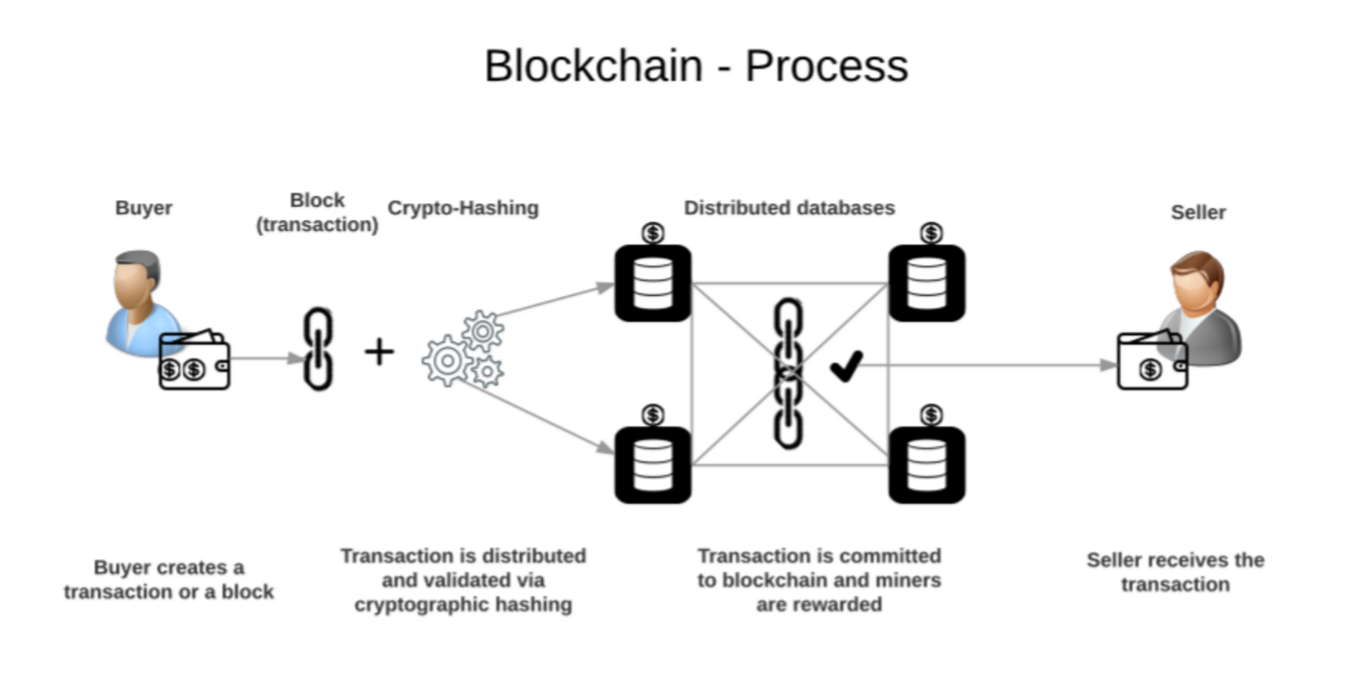
Mining
Verify if a transaction is valid
Bundle the transactions in a block
Use the header of the most recent block in the new hash
Solve the Proof of Work Problem
Add the new block to the chain, first one wins.

Slide 6
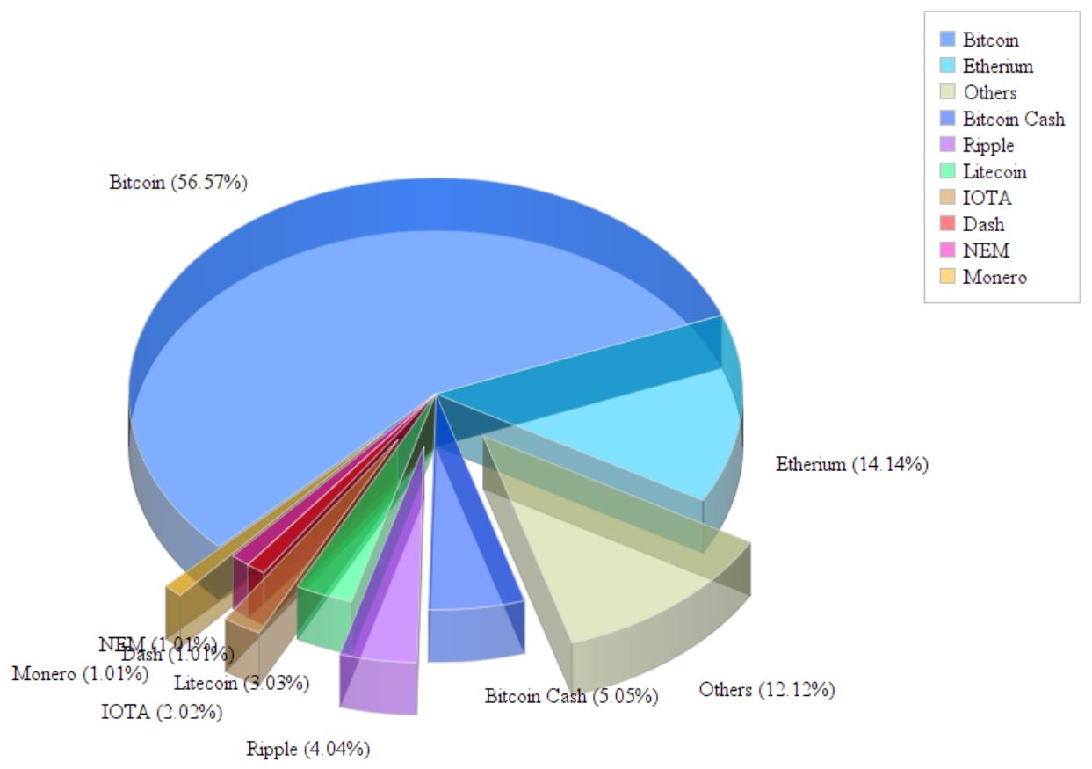
The Market for Cryptocurrency
In its infancy
Dominated by Bitcoin
Traded on over 5,400 exchanges

Slide 7

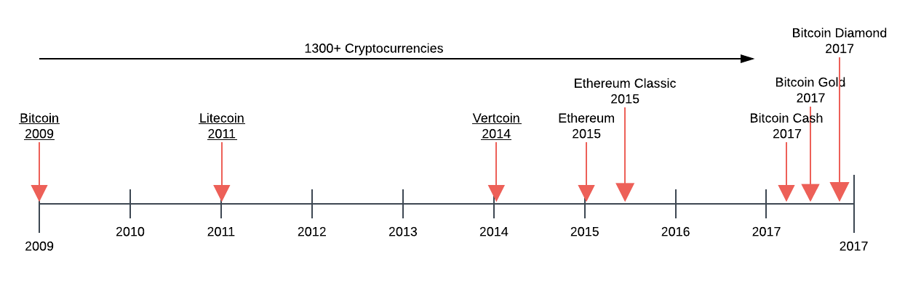
Cryptocurrency Market Growth
Market Capitalization of $821 billion
Bitcoin reach ATH of $19,536 in 2017
Represent a 20-fold increase
S&P 500 took forty years to achieve similar growth

Slide 8
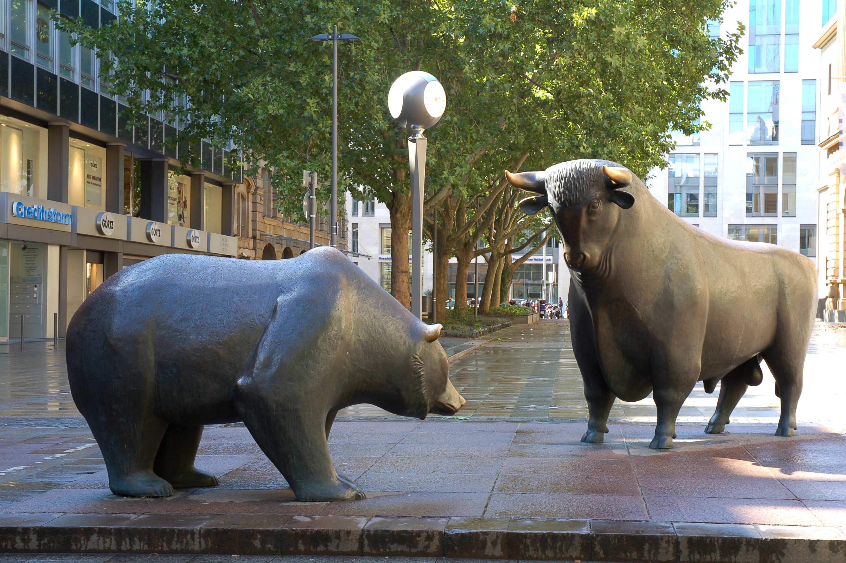
Cryptocurrency Investing
Volatility makes forecasting difficult
Not government backed
Investor hype can cause large swings
Large sell-offs not regulated
No Fundamental Indicators

Slide 9
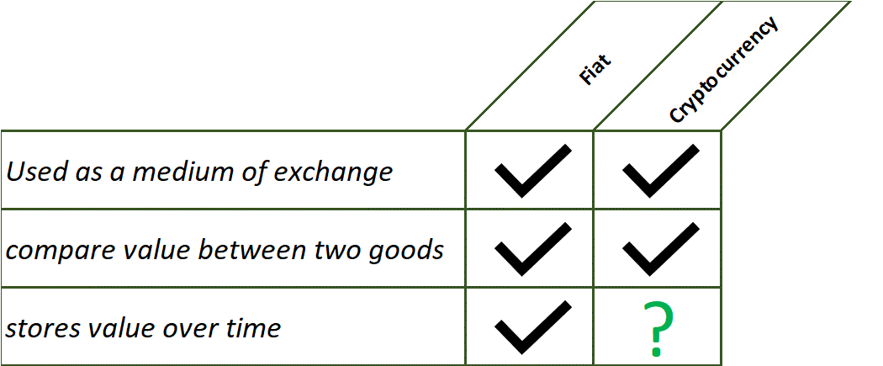
Cryptocurrency and Fiat

Slide 10
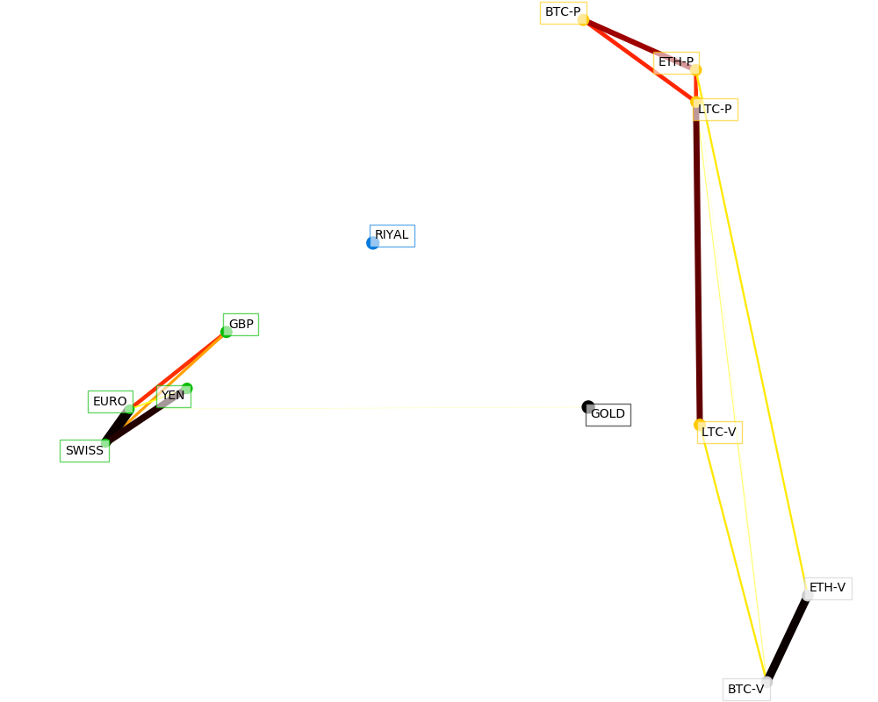
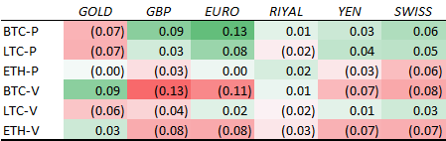
Bitcoin vs Fiat

Slide 11
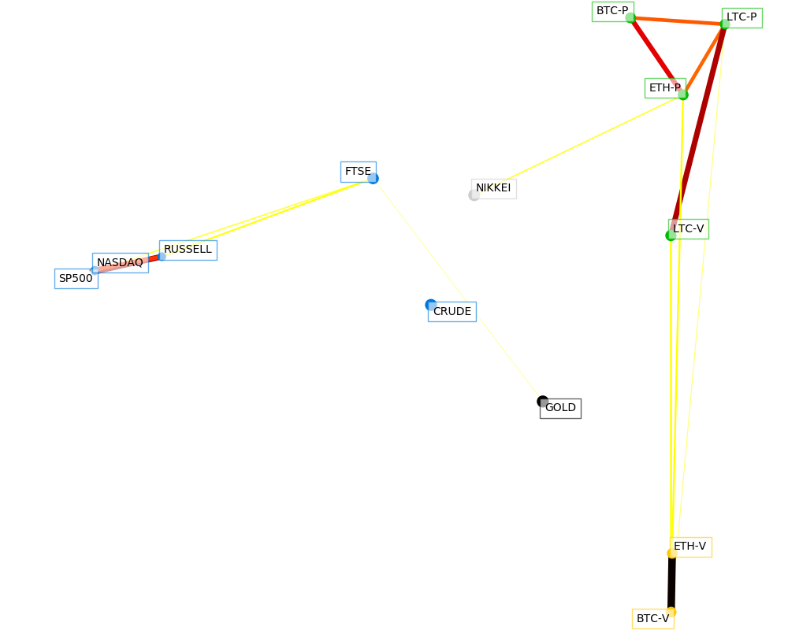
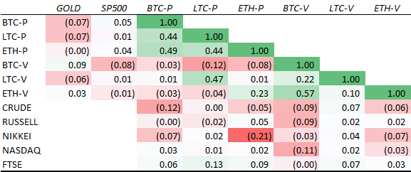
Correlation with other Assets

Slide 12
Market Analysis/Findings
Cryptocurrency needs to prove it can store value to be considered a true asset class
Bitcoin is being used as hedge against markets
Being used similar to gold

Slide 13
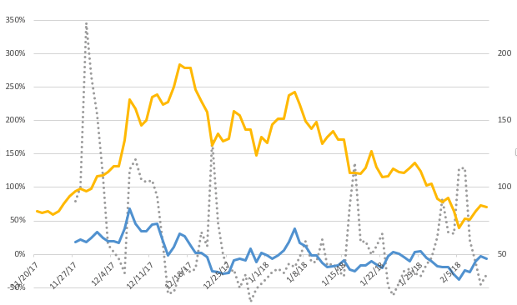
Sentiment Analysis

Slide 14
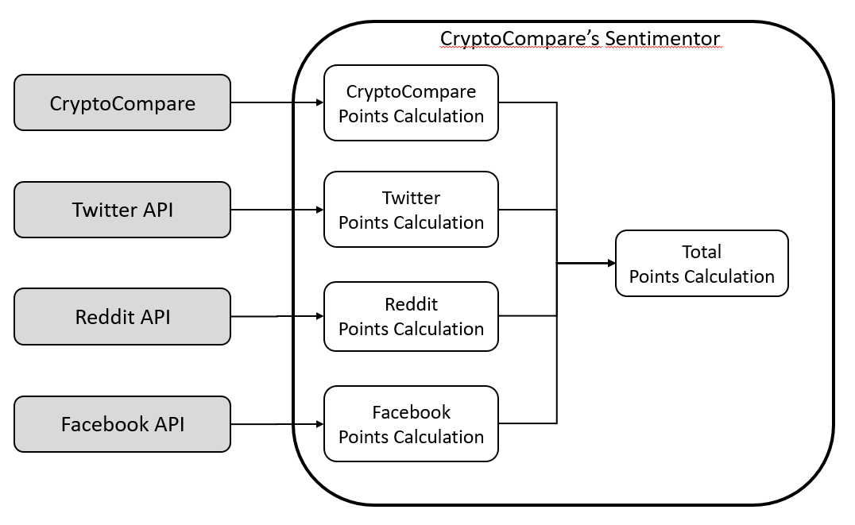
Sentiment Analysis Findings
Not enough research in the field yet
Twitter, google, yahoo search trends
Cryptocompare’s Sentiment Engine

Slide 15

Cryptovisor : A Cryptocurrency Advisory Tool
Hype around cryptocurrency
Wild fluctuation causes inconsistent data distribution
Data sampling less than a day is influenced by high frequency trading or algorithmic trading
News and rumors happen at any time and are a driving force to multi-day horizons

Slide 16
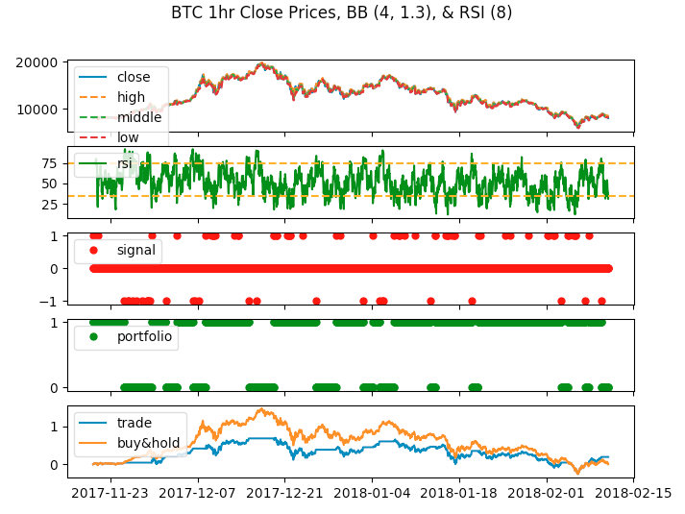
Cryptovisor – Data Used
Historical Data for Bitcoin from Cryptocompare API
October 3, 2016 to February 10, 2018
Hour by hour values
Exchange dataset read into labeler component

Slide 17
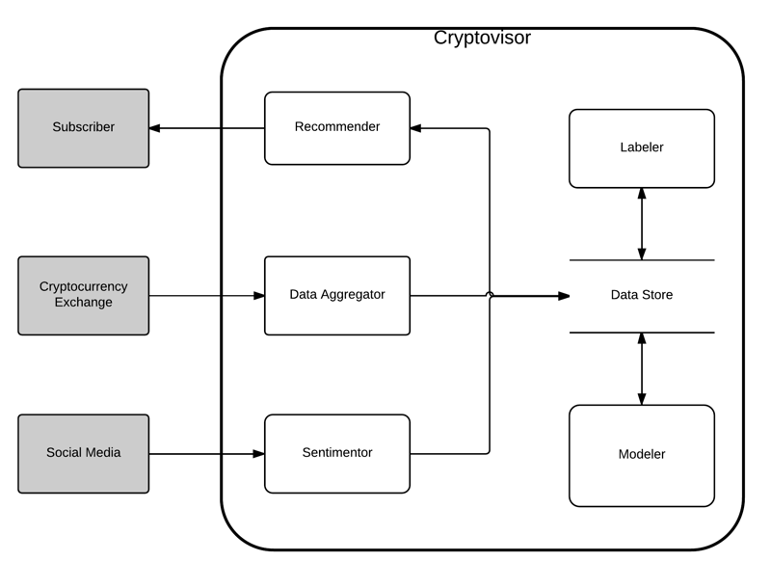
Cryptovisor – Design
System comprised of six main components
Recommender
Data Aggregator
Sentimentor
Labeler
Modeler
Data Store

Slide 18

Cryptovisor – Machine Learning
One hour time period data stream
Fitted with Bollinger Bands technical indicators
A stochastic gradient boost classifier trained with a stratified 5-fold cross validation
Calculated dataset by labeler component.

Slide 19
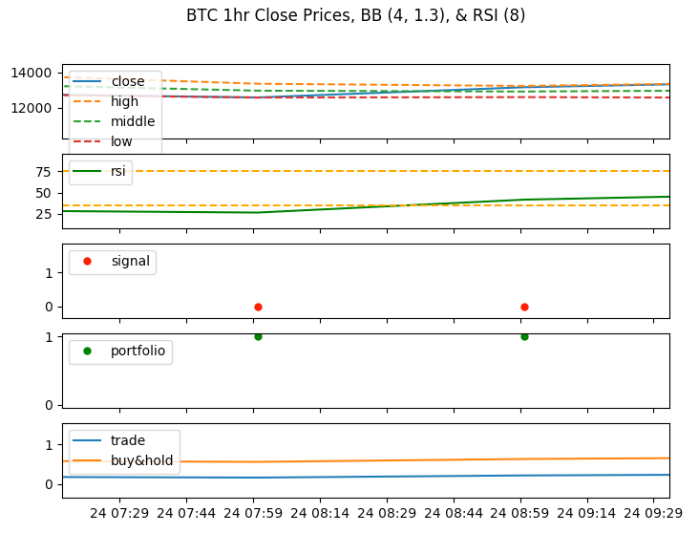
Cryptovisor - Results
Output charts from labeler component.
close price with BB in the top row
RSI with buy and sell targets in the second row
buy and sell signal points in the third row
portfolio strategy in fourth row
strategy results in fifth row

Slide 20
Cryptovisor – Results cont.
2,000 trading signals over a three-month period
The labeler component identified:
1.31% as sell signals
2.62% as buy signals
Trading strategy for the bear market beat the buy and hold strategy in an annualized return by 1.173 and Sharpe Ratio by 0.43

Slide 21
Conclusion
crypto-currency market is volatile and in its infancy
environment is risky for individual investors
current tools these investors have to employ to help them make crypto-currency investment decisions is limited
Cryptovisor, that is 95.5% accurate in determining the buy, sell or hold position for Bitcoin

